Slide 1
Instruction for how to use these slides…
If you want to lead a Lenten study group, follow slides 2-13
If you want to lead Ash Wednesday and Palm Sunday, follow slides 14-24
All slides are for lay-led options, particularly helpful for smaller churches who may or may not have access to clergy

Slide 2
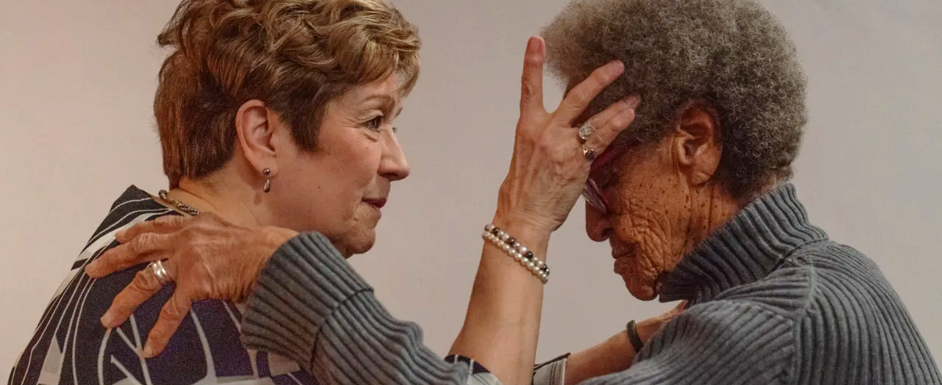

How to Do a Lay-Led Lent: Discipling Together
Northeast Convocation of the Episcopal Diocese of Texas
Notes:
Image: https://www.republicanherald.com/2025/03/05/christians-embark-on-the-holy-season/

Slide 3
Opening Prayer
Lord, make us instruments of your peace. Where there is hatred, let us sow love; where there is injury, pardon; where there is discord, union; where there is doubt, faith; where there is despair, hope; where there is darkness, light; where there is sadness, joy. Grant that we may not so much seek to be consoled as to console; to be understood as to understand; to be loved as to love. For it is in giving that we receive; it is in pardoning that we are pardoned; and it is in dying that we are born to eternal life. Amen.
BCP, A Prayer attributed to St. Francis, p. 833

Slide 4

A Reminder:
What is Lent?
”In the western church the forty days of Lent extend from Ash Wednesday through Holy Saturday, omitting Sundays … Today Lent has reacquired its significance as the final preparation of adult candidates for baptism. Joining with them, all Christians are invited ‘to the observance of a holy Lent, by self-examination and repentance; by prayer, fasting, and self-denial; and by reading and meditating on God's holy Word’ (BCP, p. 265).”
from An Episcopal Dictionary of the Church, A User Friendly Reference for Episcopalians edited by Don S. Armentrout and Robert Boak Slocum

Slide 5

Grow
Smaller
“…Congregations don’t always change by growing larger. Sometimes they ‘grow smaller’ … [they] become stronger, deeper, more centered on the message of the Gospel, and more intentional in their ministry to the world beyond the church as they contend with shifts in demographics and dollars.”
From Bivocational: Returning to the Roots of Ministry by Mark D.W. Edington

Slide 6
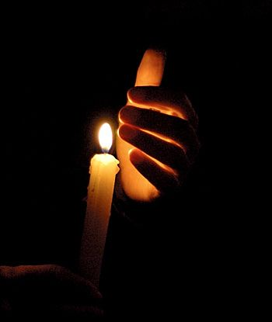
Grow
Smaller
Your parish may be a small light, but from that small light darkness is dispelled, good works can be seen, and warm fires can be lit in cold places.

Slide 7
Grow Smaller: Discipling Together During Lent
Expectations
This is not a classroom. We are not here to learn “about” something, so do not share to “teach” someone something. This is a time to experience scripture and be formed together.
Group Rules
Suspend judgement, honor diverse opinions, and use kind speech.
Speak from the heart and share at a level that is comfortable for you.
Respect others and give the benefit of the doubt.
Seek understanding rather than persuasion.
Go for honesty and depth while being concise and focused.

Slide 8
Grow Smaller: Group Reflection and Sharing
^{Warm Up Question}
What has Jesus done in your life this week?
Notes:
Part of the Gospel reading for tomorrow, Sunday, 1/8, the Fifth Sunday after Epiphany

Slide 9
Grow Smaller: Group Reflection
¹⁴⁻¹⁵ “You are the world’s light—it is impossible to hide a town built on the top of a hill. Men do not light a lamp and put it under a bucket. They put it on a lamp-stand and it gives light for everybody in the house.
¹⁶ “Let your light shine like that in the sight of men. Let them see the good things you do and praise your Father in Heaven.”
Matthew 5:14-16, J. B. Phillips New Testament translation
Notes:
Part of the Gospel reading for tomorrow, Sunday, 1/8, the Fifth Sunday after Epiphany

Slide 10
Grow Smaller: Discerning Together
10-Minutes for Each Question
What rings true for you as you read this passage?
How does this connect to your week and daily life?
What does this reveal to you about Lent?

Slide 11
Grow Smaller: Takeaways
Open Discussion
What will you take home with you from today’s conversation?

Slide 12
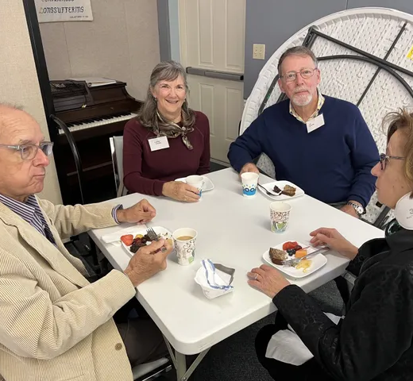
Grow Smaller: Group Reflection
Use this lay-led formation model this Lent
Utilize the Sunday Scripture from the Lectionary

Slide 13

10-Minute Comfort Break

Slide 14
How to Offer Lay-Led Lenten Services
Northeast Convocation of the Episcopal Diocese of Texas
Notes:
Image: https://www.republicanherald.com/2025/03/05/christians-embark-on-the-holy-season/

Slide 15

A Lay-Led Lent
It’s Not Easy
It’s Easy
No Priest
Limited Resources
High Expectations for Holy Days
No Priest: No Problem
Know Your Resources
Reset Expectations for Holy Days

Slide 16
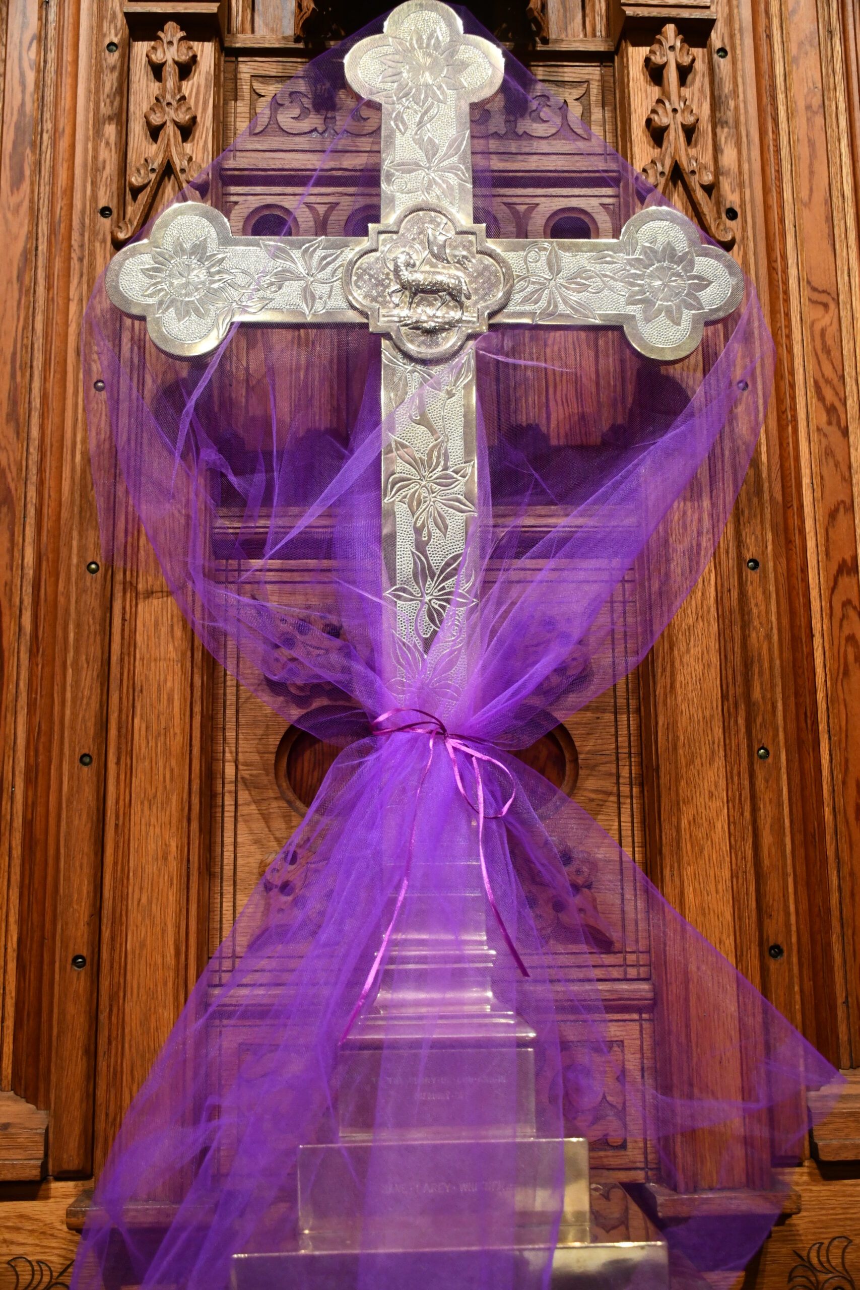
Common Lenten Worship Services
Ash Wednesday
The Sunday of the Passion: Palm Sunday

Slide 17

No Priest:
No Problem
Ash Wednesday
“In the absence of a bishop or a priest, all that precedes may be led by a deacon or lay reader.”
Palm Sunday
“In the absence of a bishop or a priest, all that precedes may be led by a deacon or lay reader.”
BCP, p.269
BCP, p.273
“…Lay Reader leading the service remains kneeling and substitutes the prayer for forgiveness appointed at Morning Prayer”

Slide 18
No Priest:
No Problem
Ash Wednesday
“In the absence of a bishop or a priest, all that precedes may be led by a deacon or lay reader.”
Palm Sunday
“In the absence of a bishop or a priest, all that precedes may be led by a deacon or lay reader.”
“Lay Reader leading the service remains kneeling and substitutes the prayer for forgiveness appointed at Morning Prayer”
BCP, p.269
BCP, p.273

Slide 19
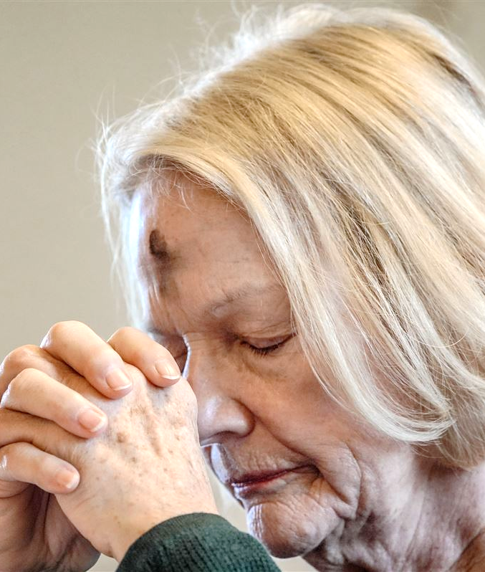
Know Your Resources
Ash Wednesday
Plan Your Liturgy
Secure Ashes by Relying on Historic Knowledge
Determine Logistics
Vest in Cassock & Surplice
Notes:
Image: https://www.republicanherald.com/2025/03/05/christians-embark-on-the-holy-season/

Slide 20

Know Your Resources
Palm Sunday
Plan Your Liturgy
Secure Palms
Determine Distributing of Palms, Opening Gospel Reader & the Procession
Vest in Cassock & Surplice

Slide 21
Know Your Resources
Ash Wednesday & Palm Sunday
Both services assume a Holy Eucharist service will follow, but lay-led services won’t have one without a priest
So, Additional Directions need to be followed:
“If there is no Communion, all that is appointed through the Prayers of the People may be said … A hymn or anthem may the be sung, and offerings of the people received. The service may then conclude with the Lord’s Prayer; and with either the Grace or a Blessing, or with the exchange of the Peace.”
BCP, pp.406 - 407

Slide 22
Know Your Resources
What the Additional Directions Look Like in the Liturgy
The Peace
The Offering with Offertory Hymn (Not on Ash Wednesday)
The Lord’s Prayer
A Blessing
Recessional Hymn (Not on Ash Wednesday)
Dismissal

Slide 23
Other Lenten Worship Services
Way of the Cross
          Book of Occasional Services, p. 53
A Scriptural Way of the Cross
          Book of Occasional Services, p. 58
Evening Prayer
          BCP, p. 115

Slide 24
Reset
Expectations
Your parish may be a small light, but from that small light darkness is dispelled, good works are seen, and warm fires can be lit in cold places.

